Slide 1
DETECTING TERRORIST NETWORKS
By Sushama Shankar, Akash Govind Kuttikad and Thihan Moe Kyaw

Slide 2
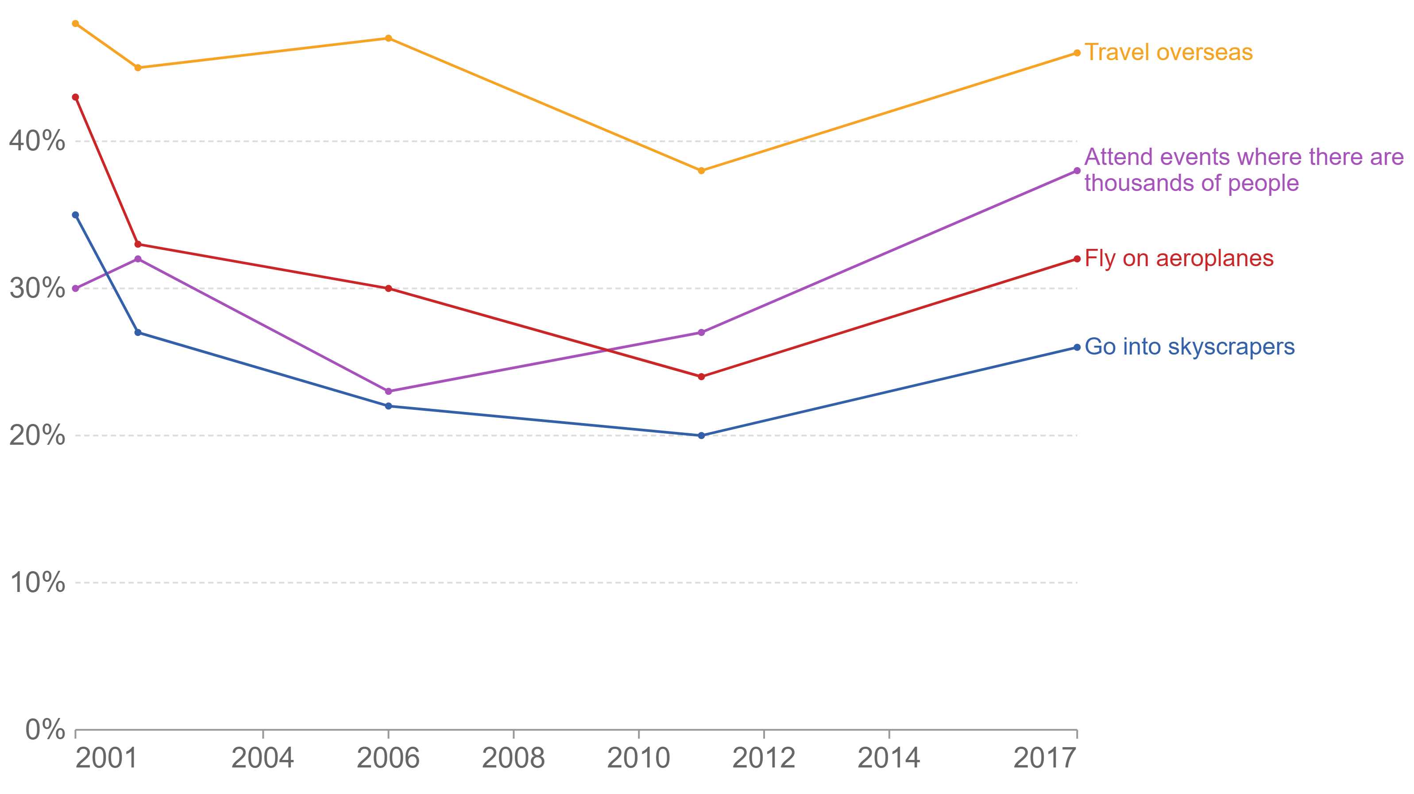
Share of US citizens who say they’re less willing to do certain activities due to terrorism
Source: Gallup Survey (2017)

Slide 3
Proliferation and influence of terrorist groups
No political or ideologically driven organization can survive or thrive without a support network, which includes: (Bandura, A. (2004), Borum, R. (2004))
Financial support
Weapons,
Organizational and operational support
Source: Bandura, A. (2004). The origins and consequences of moral disengagement: A social learning perspective.
Borum, R. (2004). Psychology of terrorism. Tampa: University of South Florida.

Slide 4
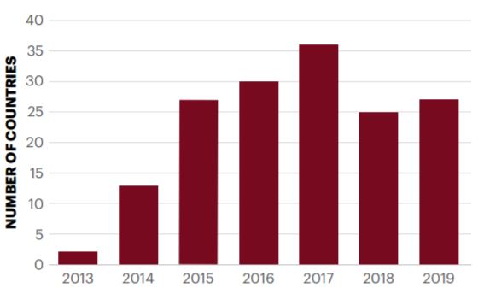
Proliferation and influence of terrorist groups
Islamic State of Iraq and the Levant (ISIL) and its predecessors were responsible for at least 17 per cent of total deaths from terrorism over the past decade. (Source: Global Terrorism Index 2020)
Number of countries recording ISIL-related attacks, 2013-2019 (excludes Iraq and Syria)
Source: START GTD, IEP calculations
Source: Global Terrorism Index 2020: Measuring the Impact of Terrorism, Sydney, November 2020.

Slide 5
What do we observe from the spread of ISIL?
ISIL first emerged in the early 2000s from local militant outfits.
ISI, its immediate predecessor was formed in 2010 by surviving members of Al-Qa’ida in Iraq (AQI) and former members of the US-trained Sons of Iraq.
ISIL-related groups have recorded over 3,000 attacks in 48 countries other than Iraq and Syria, since 2013.
ISIL’s global reach has steadily expanded with provinces and affiliated groups conducting attacks across six regions: Asia-Pacific, Europe, MENA, Russia and Eurasia, South Asia and sub-Saharan Africa.
In the West, ISIL directed or inspired at least 78 terror attacks between 2014 and 2019, resulting in 471 fatalities.
Number of countries recording ISIL-related attacks, 2013-2019 (excludes Iraq and Syria)
Source: START GTD, IEP calculations
Source: Global Terrorism Index 2020: Measuring the Impact of Terrorism, Sydney, November 2020.

Slide 6
Global Terrorism Database
Event-level database consisting with more than 200,000 records of attacks from 1970 till 2019
Developed and maintained by the National Consortium for the Study of Terrorism and Responses to Terrorism (START) at the University of Maryland.
Includes information on at least 45 variables for each case, with more recent incidents including information on more than 120 variables, which include
Incident date
Location
Target type
Perpetrator information
Weapon information
Casualty

Slide 7
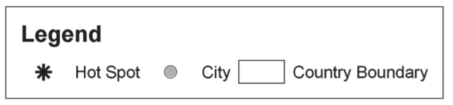
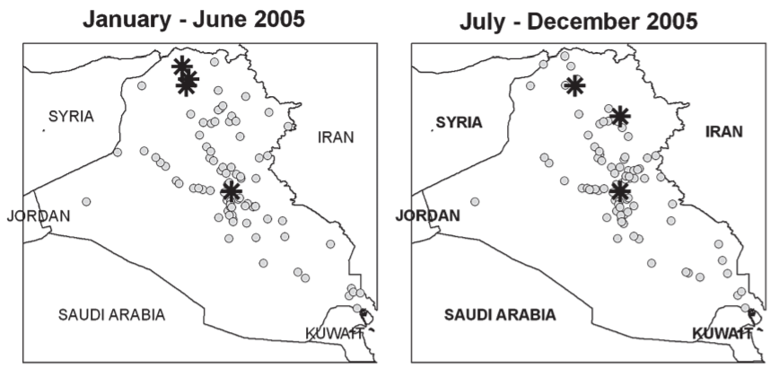
Similarity criteria between terrorist events
Spatial/geographic proximity
Importance:
Can help identify hotspots
Target destinations of specific terrorist groups
Minimal change in target destinations over a span of one year in images 1 and 2 demonstrate increased probability of one event “following” another
Evolution of hotspots of attacks carried out in Iraq during 2005
Source: Global Terrorism Index 2020: Measuring the Impact of Terrorism, Sydney, November 2020.

Slide 8
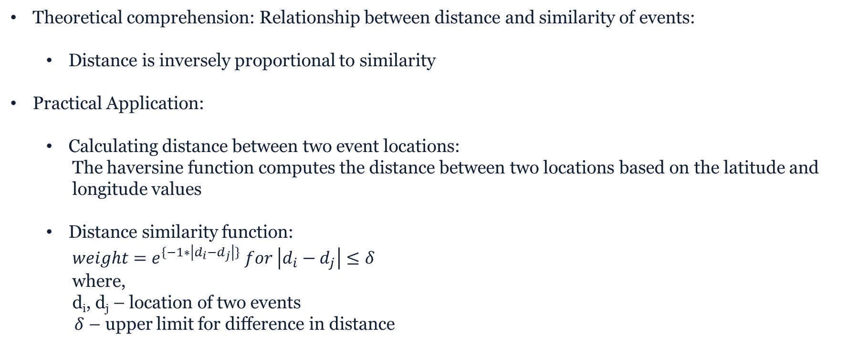
Similarity criteria between terrorist events
Spatial/geographic proximity
Theoretical comprehension: Relationship between distance and similarity of events:
Distance is inversely proportional to similarity
Practical Application:
Calculating distance between two event locations:
The haversine function computes the distance between two locations based on the latitude and
longitude values
Distance similarity function:
${weight=e}^{\{−1∗\left|d_{i}−d_{j}\right|\}} for \left|d_{i}−d_{j}\right|≤δ$
where,
d_{i}, d_{j} – location of two events
$δ$ – upper limit for difference in distance

Slide 9
Similarity criteria between terrorist events
Temporal proximity
Importance:
Target destinations of specific terrorist groups in a narrow time gap
Identification of copycat events
Deduce patterns of non-random attacks within a time frame
Minimal time window between two terrorist attacks in Iraq, increasing probability of one event “following” another
(Jenkins et al., RAND Corporation, 2016)
Evolution of hotspots of attacks carried out in Iraq during 2005
Source: Global Terrorism Index 2020: Measuring the Impact of Terrorism, Sydney, November 2020.
Jenkins, Brian Michael, Henry H. Willis, and Bing Han, Do Significant Terrorist Attacks Increase the Risk of Further Attacks? Initial Observations from a Statistical Analysis of Terrorist Attacks in the United States and Europe from 1970 to 2013. Santa Monica, CA: RAND Corporation, 2016. https://www.rand.org/pubs/perspectives/PE173.html.

Slide 10
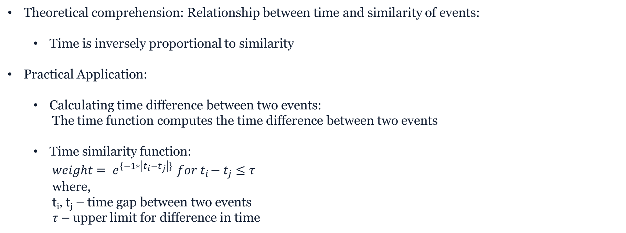
Similarity criteria between terrorist events
Temporal proximity
Theoretical comprehension: Relationship between time and similarity of events:
Time is inversely proportional to similarity
Practical Application:
Calculating time difference between two events:
The time function computes the time difference between two events
Time similarity function:
${weight= e}^{\{−1∗\left|t_{i}−t_{j}\right|\}}{ for t}_{i}−t_{j}≤τ$
where,
t_{i}, t_{j} – time gap between two events
$τ$ – upper limit for difference in time

Slide 11
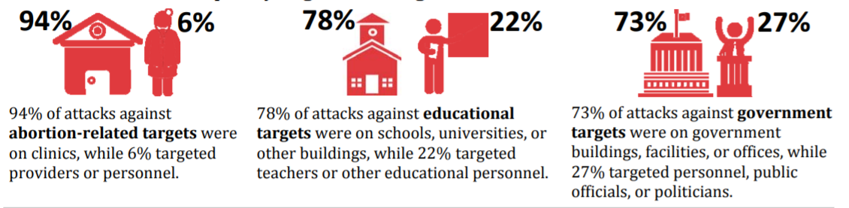
Similarity criteria between terrorist events
Target type: The most frequently attacked type of target in the United States between 1970 and 2013 was business targets. Nearly one-third of all attacks on business targets were on banks/commerce, and an additional 23% were on retail entities
Source: Miller E., START Novemeber 2014, Terrorist Attacks in the U.S. Between 1970 and 2013: Data from the Global Terrorism Database (GTD)

Slide 12
Similarity criteria between terrorist events
Target Group Equality
Theoretical comprehension: Relationship between target group and similarity of events:
If the target group is the same, there exists a similarity between two terrorist attacks
Motivated by the fact that groups with similar ideologies attack the same target groups
Practical Application:
Checking for similarity through target groups:
A simple equality check between target groups of two events under consideration permits further
weight addition to the edges based on spatial and temporal relevance.

Slide 13

Formation of events graph
Based on the aforementioned similarity criteria, a graph connecting various terrorist events in the United States was formed.
Graph directed from influencer to the influenced event.
Total number of nodes = Number of events = 2437
Total number of edges = 186789
Top 8 influential events have been identified by calculating closeness centrality value of each node.

Slide 14
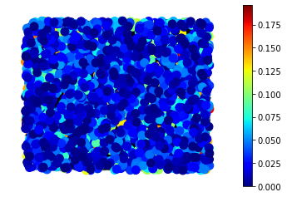
Closeness centrality of events graph
Range varies from 0.19589 to 0.
Centralization of the graph formed = 0.3088
Top 8 influential events and corresponding groups:
Event ID | Closeness value | Group name
251 | 0.19589 | Revolutionary Force 26
252 | 0.19589 | Revolutionary Force 26
37 | 0.19429 | Strikers
243 | 0.19423 | Black Nationalists
570 | 0.18812 | Black Nationalists
593 | 0.18773 | Black Nationalists
228 | 0.18699 | Left-Wing Militants
229 | 0.18699 | Left-Wing Militants

Slide 15
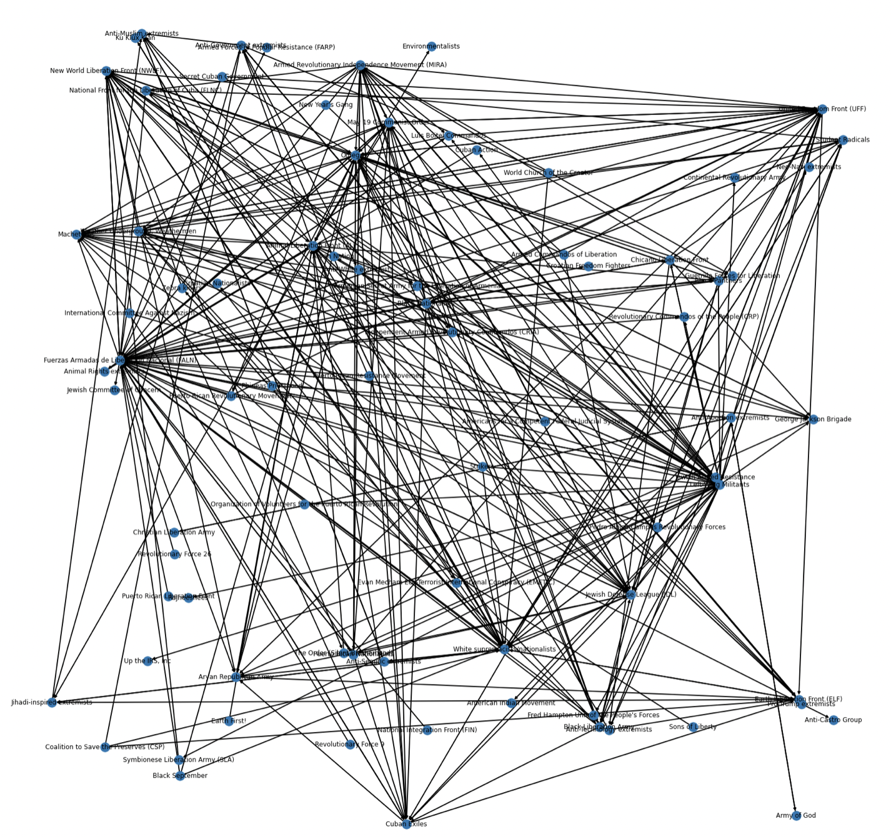
Network with terrorist groups as nodes
Edge included between two groups if one has followed more than 100 events ‘similar’ to another.
Number of events followed between groups (initial edge weight) varies between 1 and 2779
Number of nodes = 79
Number of edges = 306

Slide 16
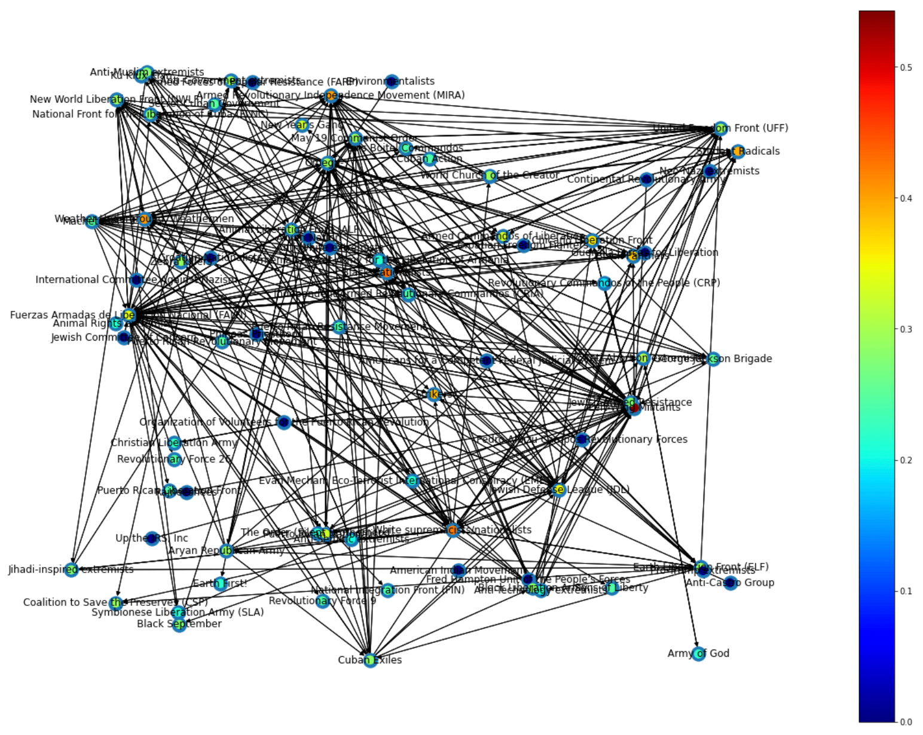
Closeness centrality for the groups
Range of values of closeness: 0.54299 to 0
Top 5 influential groups in order of closeness centrality:
Group name | Closeness centrality
Left-Wing Militants | 0.54299
White Supremacists/Nationalists | 0.42735
Jewish Defence League | 0.42343
Black Nationalists | 0.40486
Weather Underground, Weathermen | 0.40134

Slide 17
Maximum relaxed-star found in the graph
Formulation:
Data:
H (V, E) – Graph with terrorist groups as vertices and number of events they influence as edge weight
λ – Constant limiting the number of connections between leaves
Variables:
x_{i} = {0,1}, 1 if the node is the center of the star, 0 otherwise
y_{i} = {0,1}, 1 if the node is a leaf, 0 otherwise
k_{ij} = {0,1}, 1 if connection (i, j) is allowed between leaves, 0 otherwise
w_{ij} = {0,1}, linearisation term used in Fortet’s linearisation

Slide 18
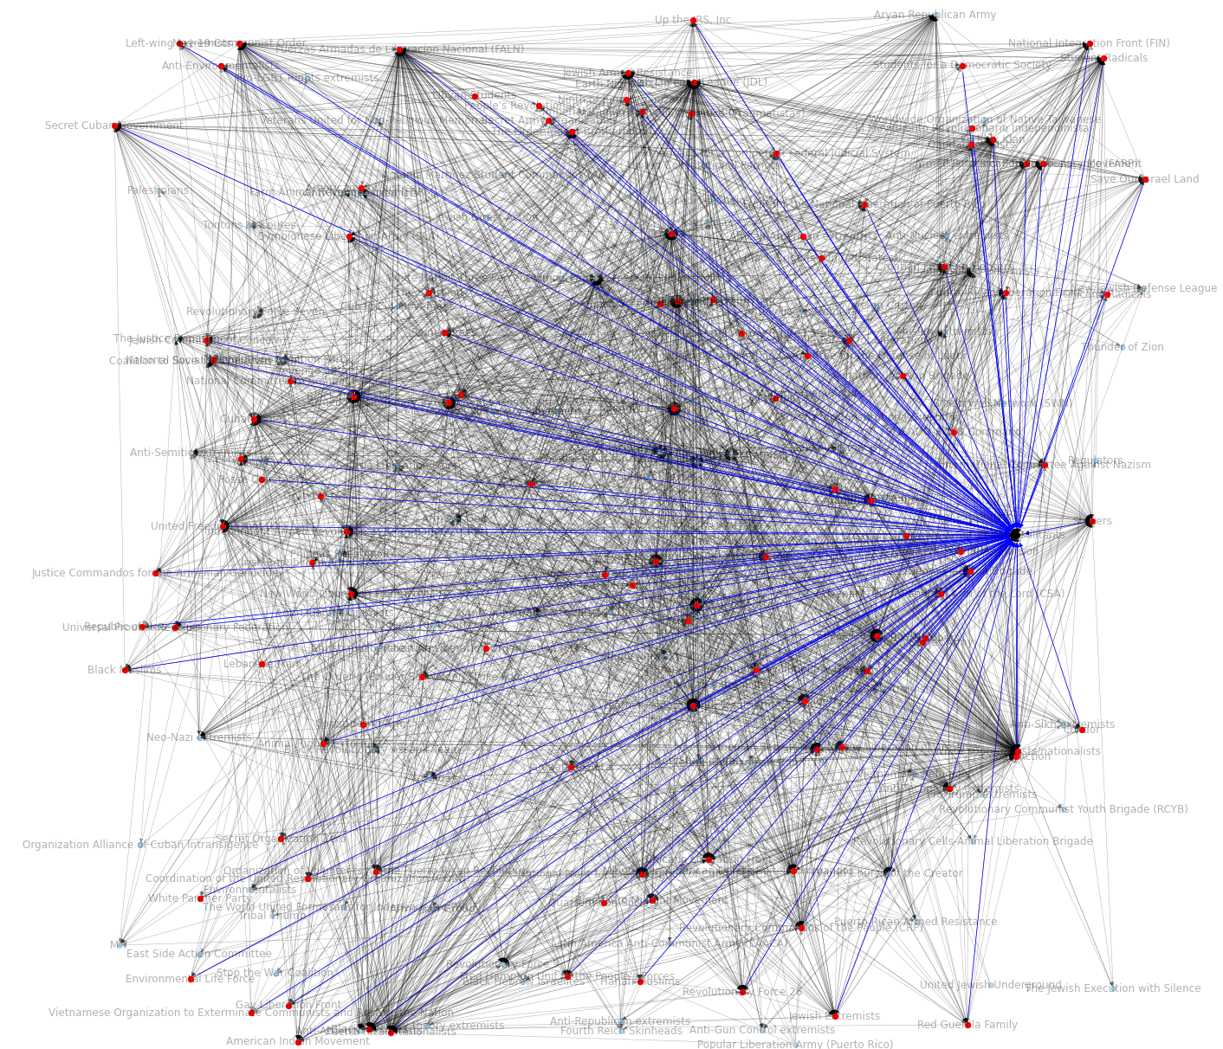
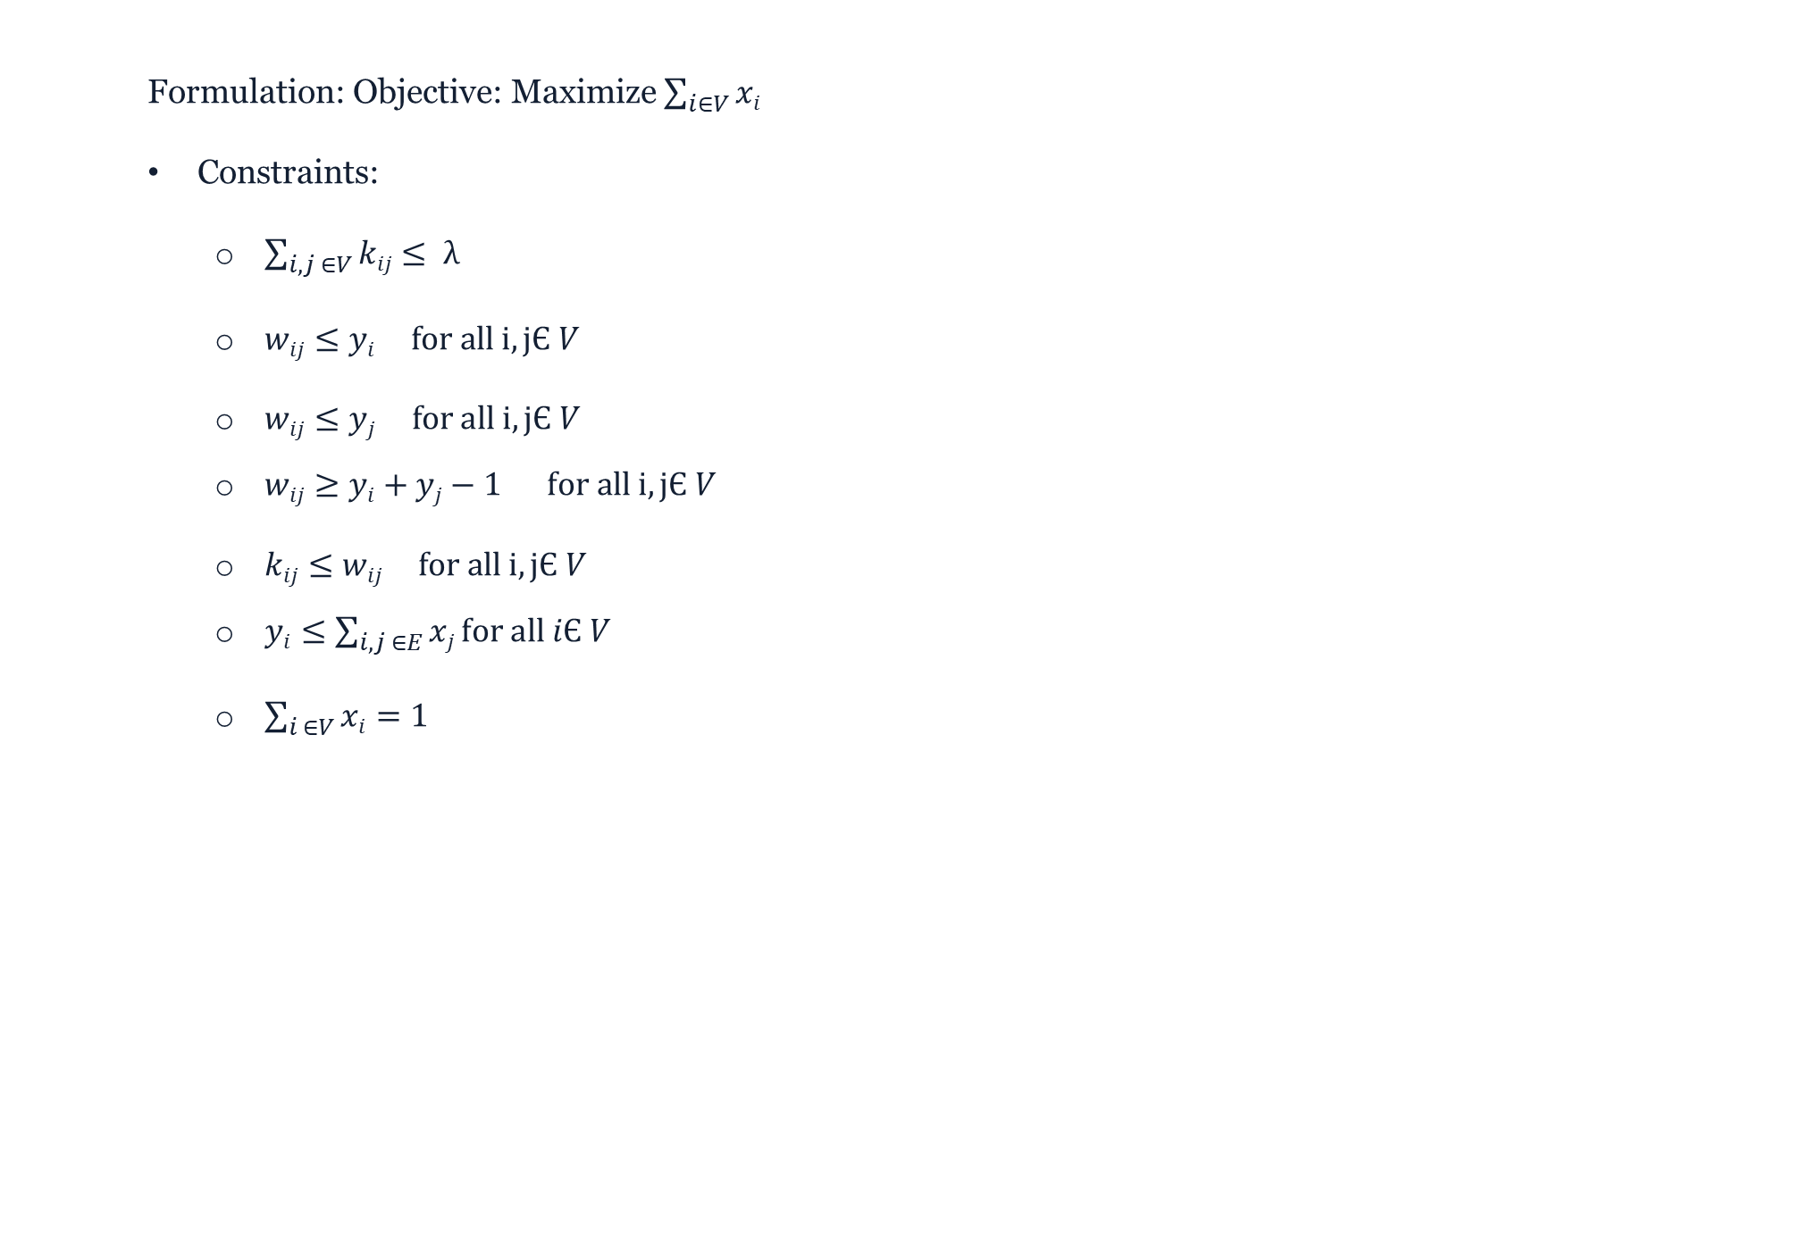
Maximum relaxed-star found in the graph
Formulation: Objective: Maximize $\sum_{i∈V}{xi}$
Constraints:
$\sum_{i,j ∈V}{kij}≤ λ$
$wij≤yi for all i,jЄ V$
$wij≤yj for all i,jЄ V$
$wij≥yi+yj−1 for all i,jЄ V$
$kij≤wij for all i,jЄ V$
$yi≤\sum_{i,j ∈E}{xj}for all iЄ V$
$\sum_{i ∈V}{xi}=1$

Slide 19
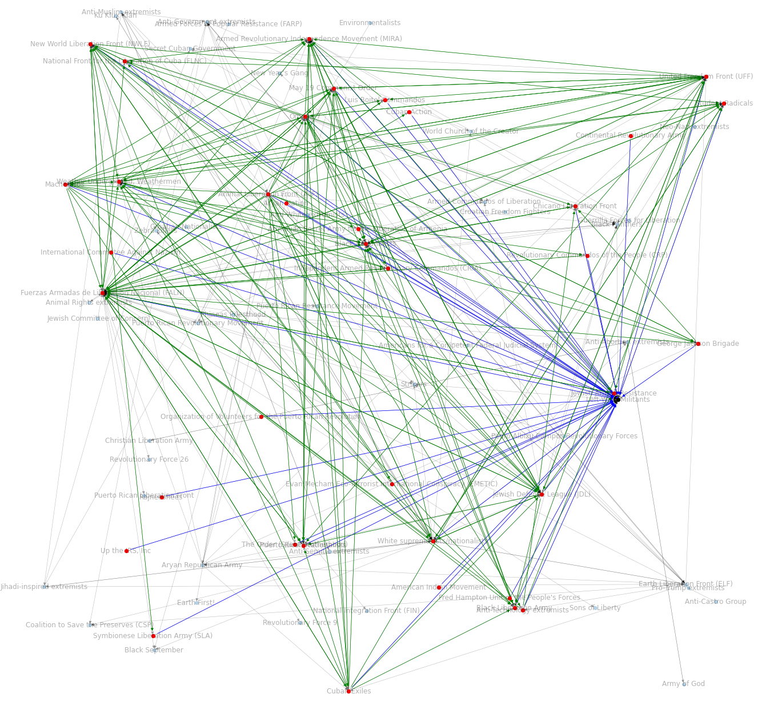
Maximum relaxed-star found in the graph
Final Outcome
Maximum relaxed star obtained with Left-Wing Militants as the center (Interestingly, this has the maximum closeness centrality as well!)
Allowed relaxation of the star = 20
Blue node - center of the star
Red nodes – leaves of the star
Blue edges – star edges between center and leaves
Green edges – Relaxed edges allowed between leaves

